Slide 1
ATP: Energy Source of the cell

Slide 2
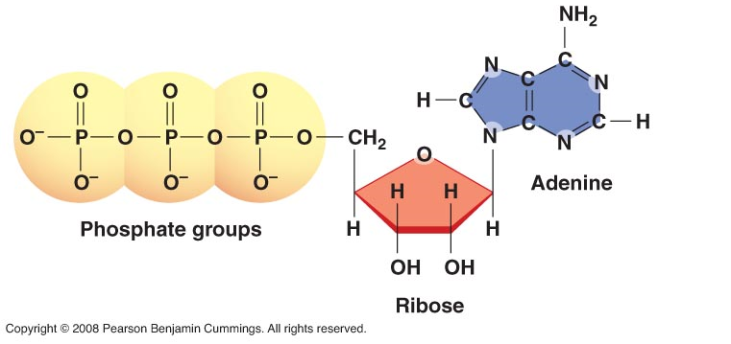
ATP: Energy Source of the cell
What is ATP?

Slide 3
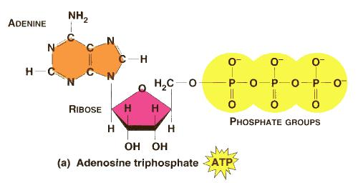
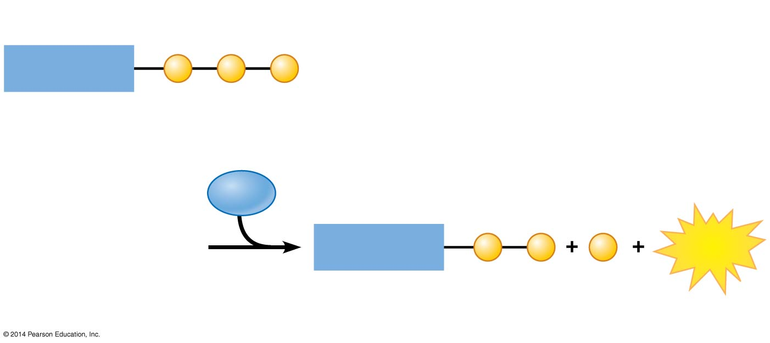
ATP drives cellular work by coupling exergonic and endergonic reactions
ATP, adenosine triphosphate, powers nearly all forms of cellular work.
ATP consists of _______________and a _______________ tail (3 phosphates)
____________________of ATP releases
energy by transferring its third
phosphate from ATP to some other molecule in a process called ___________________
adenosine
triphosphate
hydrolysis
phosphorylation.
Triphosphate
Adenosine
P
P
P
ATP
H₂O
Diphosphate
Adenosine
P
P
P
Energy
Phosphate
Notes:
3

Slide 4
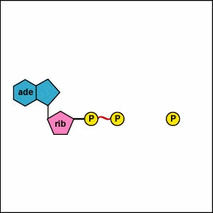
ATP drives cellular work by coupling exergonic and endergonic reactions
regenerates
A cell uses and ________________ ATP continuously.
In the ATP cycle, energy released in an exergonic reaction, such as the breakdown of glucose during cellular respiration, is used in an endergonic reaction to generate ATP from ADP.
Notes:
4

Slide 5
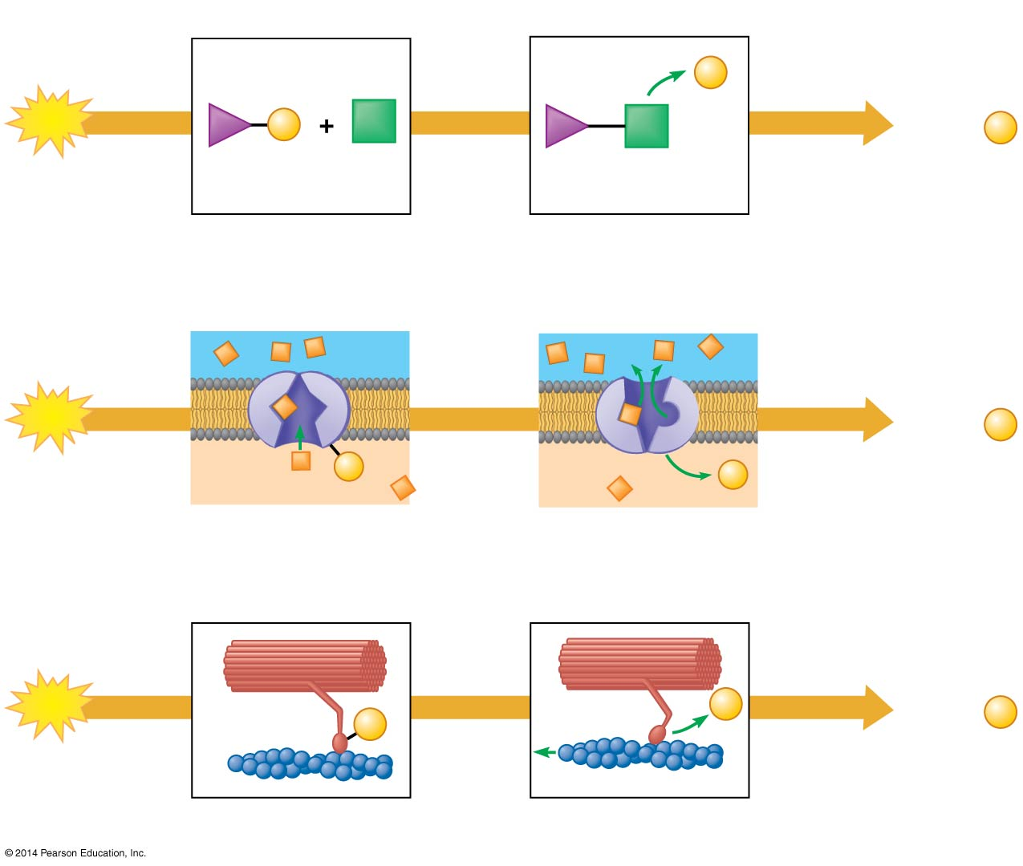
ATP drives cellular work by coupling exergonic and endergonic reactions
There are three main types of cellular work:
_______________
______________
_______________
ATP drives all three of these types of work.
chemical
Chemical work
transport
P
ATP
P
ADP +
P
mechanical
Reactants
Product formed
Transport work
ATP
ADP +
P
P
P
Transport protein
Solute transported
Mechanical work
ATP
P
P
ADP +
P
Motor protein
Protein filament moved
Notes:
5

Slide 6
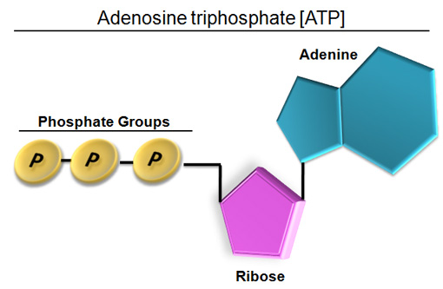
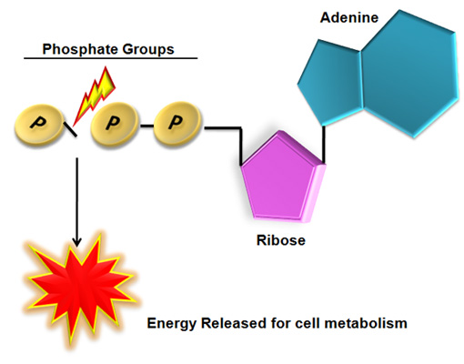
P
P
CELLULAR RESPIRATION
RECHARGES ADP
Adenosine diphosphate
(ADP)

Slide 7
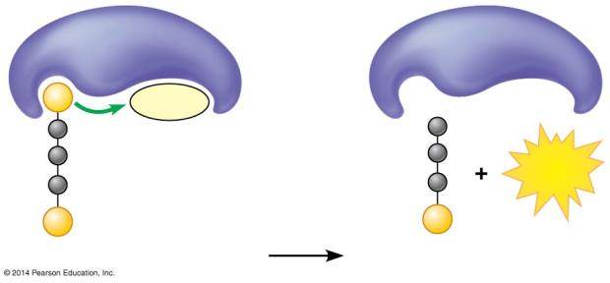
Substrate Level Phosphorylation
ATP is formed during cellular respiration, but also can be formed by substrate-level phosphorylation during which an enzyme transfers a phosphate group from a substrate molecule to ADP and ATP is formed.
Enzyme
Enzyme
P
ADP
ATP
P
P
Substrate
Product
Notes:
7

Slide 8
Cellular Respiration: Aerobic Harvesting of Energy

Slide 9
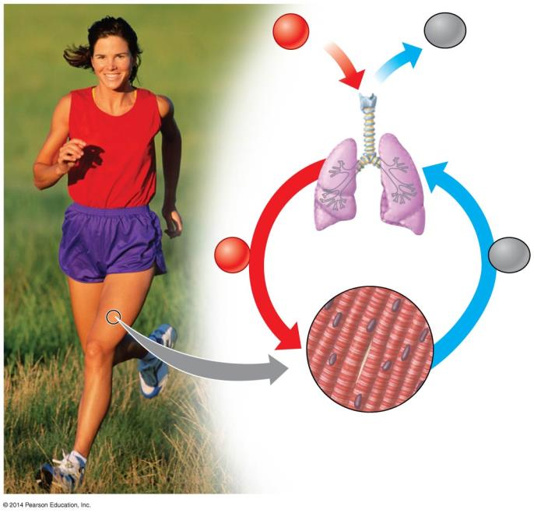
Breathing supplies O₂ and removes CO₂ in cellular respiration
Respiration,(as it relates to breathing), and cellular respiration are not the same.
Respiration, in the breathing sense, refers to an exchange of gases. Usually an organism brings in oxygen from the environment and releases waste CO₂.
Cellular respiration is the aerobic (oxygen-requiring) harvesting of energy from food molecules by cells.
Breathing
O₂
CO₂
Lungs
O₂
Transported in bloodstream
CO₂
Muscle cells carrying out
Cellular Respiration
Glucose + O₂ ➞ CO₂ + H₂O + ATP
Notes:
9

Slide 10
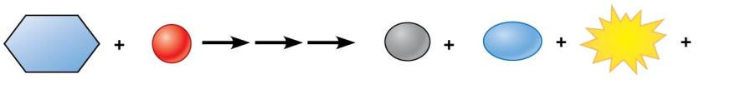
Cellular respiration banks energy in ATP molecules
Cellular respiration is an exergonic (energy- releasing) process that transfers energy from the bonds in __________to form______
Cellular respiration can produce up to ___________molecules for________glucose molecule and use about _______of the energy originally stored in glucose, releasing the other 66% as_______
This energy conversion efficiency is better than most energy conversion systems compared to only 25% of the energy in gasoline produces the kinetic energy of movement.
glucose
ATP.
32 ATP
one
34%
heat
C₆H₁₂O₆
6
O₂
6
CO₂
6
H₂O
ATP
Heat
Glucose
Oxygen
Carbon dioxide
Water
Notes:
10

Slide 11
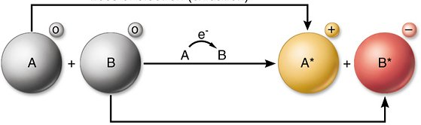
Cells capture energy from electrons “falling” from organic fuels to oxygen
Oxidation-reduction reaction, or redox reaction.
The movement of ___________________from one molecule to another.
the loss of electrons from one substance is called ___________ and the addition of electrons to another substance is called ______________
a molecule is ____________when it loses one or more electrons, and a molecule is _____________when it gains one or more electrons.
electrons
oxidation
reduction
oxidized
reduced
Notes:
11

Slide 12
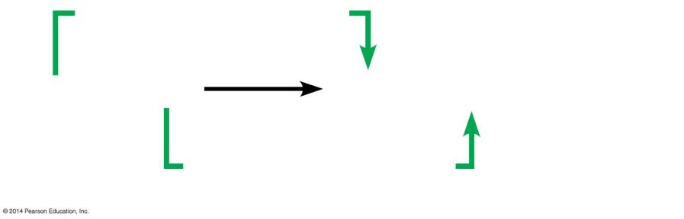
Cells capture energy from electrons “falling” from organic fuels to oxygen
A cellular respiration equation is helpful to show the changes in hydrogen atom distribution.
Glucose ________its hydrogen atoms and becomes ____________ to CO₂.
Oxygen _________hydrogen atoms and becomes _____________ to H₂O.
loses
oxidized
gains
reduced
Loss of hydrogen atoms (becomes oxidized)
C₆H₁₂O₆ + 6 O₂
6 CO₂ + 6 H₂O + ATP + Heat
(Glucose)
Gain of hydrogen atoms (becomes reduced)
Notes:
12

Slide 13
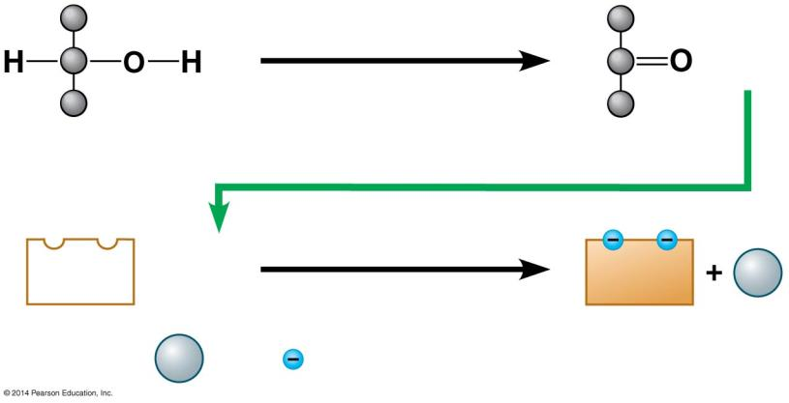
Cells capture energy from electrons “falling” from organic fuels to oxygen
An important player in the process of oxidizing glucose is a coenzyme called ________which accepts electrons and becomes reduced to___________. (electron acceptors)
NAD⁺ + 2e_ +H NADH
NAD⁺,
NADH
Becomes reduced
NAD⁺
+ 2 H
NADH
H⁺
(carries) 2 electrons)
2
H⁺
+
2
Notes:
13

Slide 14
Stages of Cellular Respiration

Slide 15
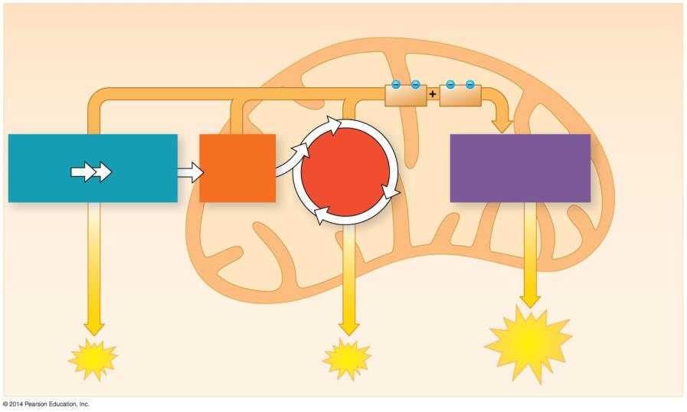
Overview: Cellular respiration occurs in three main stages
Cellular respiration consists of a sequence of steps that can be divided into three stages.
Stage 1: Glycolysis (occurs in cytosol)
Stage 2: Pyruvate oxidation and the citric acid cycle occurs in
Stage 3: Oxidative phosphorylation or ETC mitochondria
Electrons carried by
NADH
FADH₂
Glycolysis
Oxidative Phosphorylation (Electron transport and chemiosmosis)
Glucose
Pyruvate
Pyruvate Oxidation
Citric Acid Cycle
CYTOSOL
MITOCHONDRION
Substrate-level phosphorylation
Substrate-level phosphorylation
ATP
Oxidative phosphorylation
ATP
ATP
Notes:
15

Slide 16
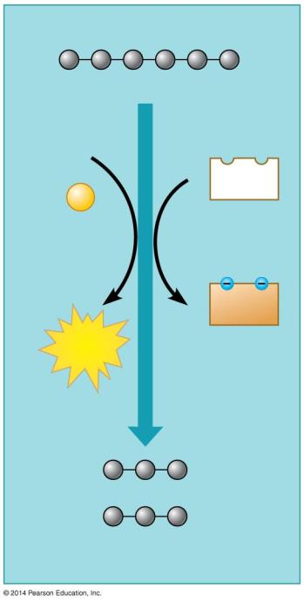
Glycolysis harvests chemical energy by oxidizing glucose to pyruvate
In glycolysis:
a single molecule of glucose is enzymatically ______in half through a series of steps
two molecules of _____________ are produced
two molecules of NAD⁺ are _____________to two molecules of__________
there is a _____gain of _________molecules of ATP (produced by substrate level phosphorylation).
split
Glucose
2 ADP
2
NAD⁺
pyruvate
+2
P
reduced
2
NADH
NADH
2
ATP
+2 H⁺
NET
two
2 Pyruvate
Notes:
16

Slide 17
Glycolysis harvests chemical energy by oxidizing glucose to pyruvate
ATP is formed in glycolysis by substrate-level phosphorylation during which an enzyme transfers a phosphate group from a substrate molecule to ADP and ATP is formed.
Enzyme
Enzyme
P
ADP
ATP
P
P
Substrate
Product
Notes:
17

Slide 18
Glycolysis harvests chemical energy by oxidizing glucose to pyruvate
The steps of glycolysis have two main phases.
the energy investment phase and the energy payoff phase
Notes:
18

Slide 19
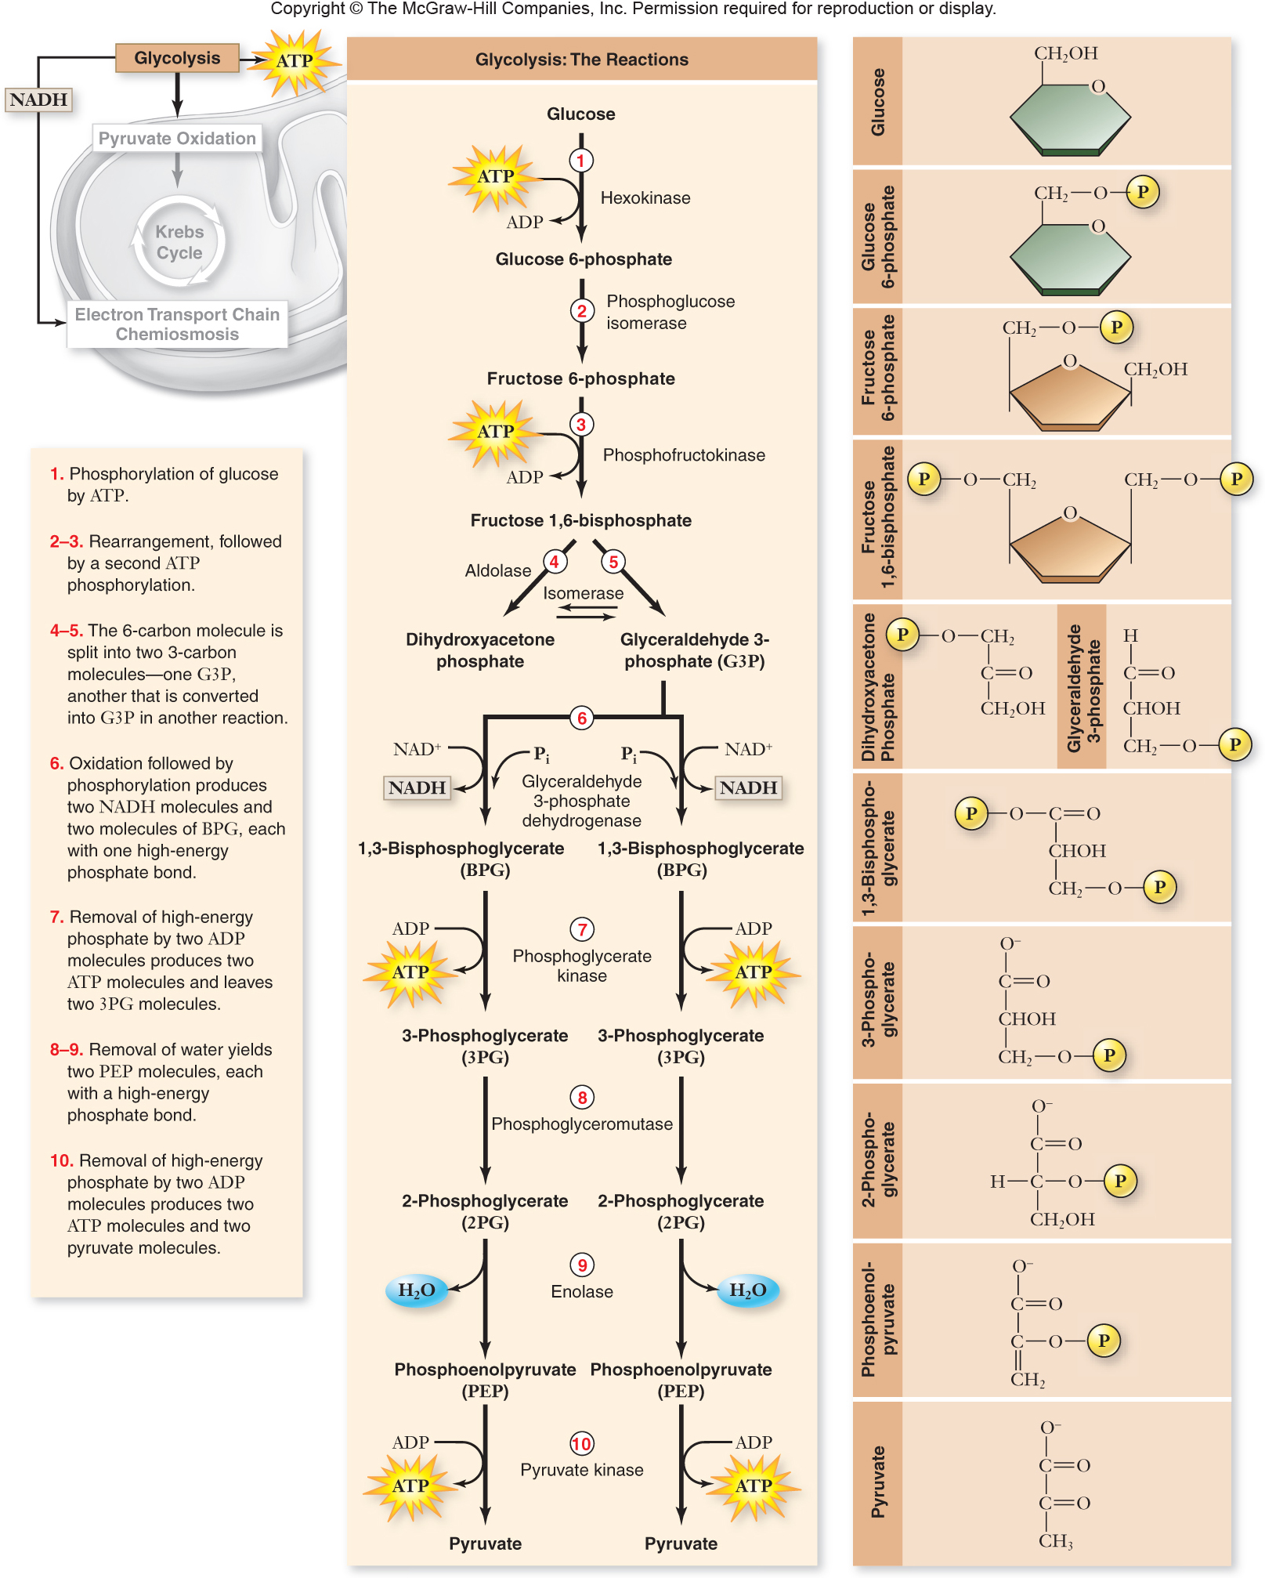

Slide 20
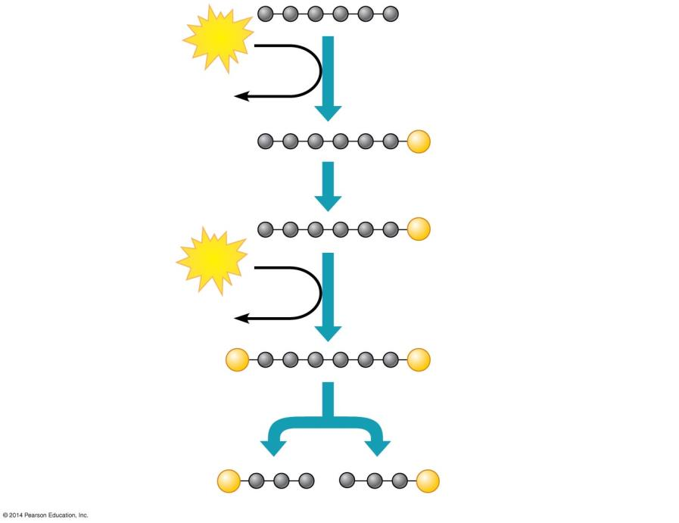
ENERGY INVESTMENT PHASE
Glucose
ATP
Steps – Glucose is energized, using ATP.
Step
1
3
1
ADP
P
Glucose 6-phosphate
2
P
Fructose 6-phosphate
ATP
3
ADP
Step A six-carbon intermediate splits into two three-carbon intermediates.
4
P
P
Fructose 1,6-bisphosphate
4
P
P
Glyceraldehyde 3-phosphate (G3P)

Slide 21
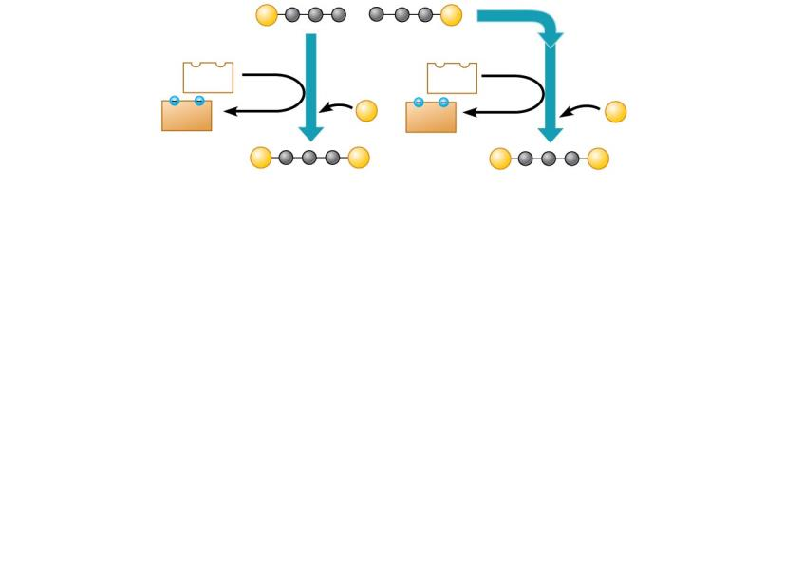
P
P
Glyceraldehyde 3-phosphate (G3P)
Step A redox reaction generates NADH.
NAD⁺
NAD⁺
ENERGY PAYOFF PHASE
5
5
5
NADH
P
NADH
P
+ H⁺
+ H⁺
P
P
P
P
1,3-Bisphosphoglycerate

Slide 22
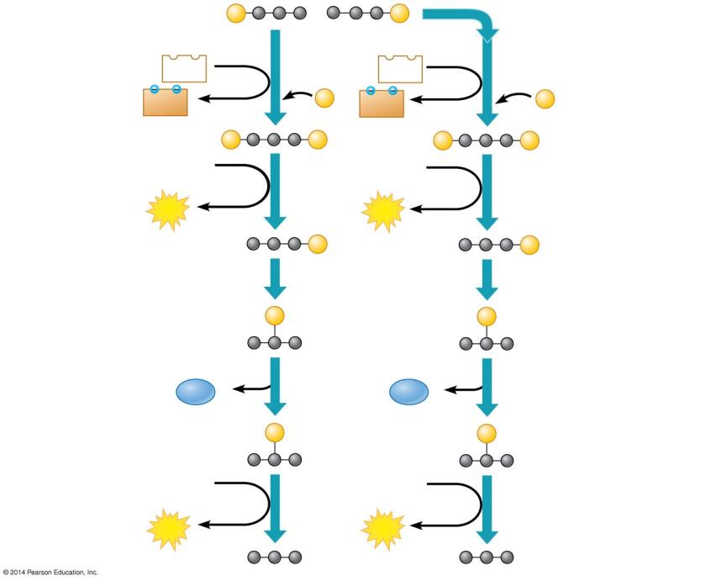
ENERGY PAYOFF PHASE
P
P
Glyceraldehyde 3-phosphate (G3P)
Step A redox reaction generates NADH.
NAD⁺
NAD⁺
5
5
5
NADH
P
NADH
P
+ H⁺
+ H⁺
P
P
P
P
1,3-Bisphosphoglycerate
ADP
ADP
Steps – ATP and pyruvate are produced.
6
6
6
9
ATP
ATP
P
P
3-Phosphoglycerate
7
7
P
P
2-Phosphoglycerate
H₂O
8
H₂O
8
P
P
Phosphoenolpyruvate (PEP)
ADP
ADP
9
9
ATP
ATP
Pyruvate

Slide 23
Pyruvate is oxidized in preparation for the citric acid cycle
90%
At the finish of glycolysis, ________of the stored energy still remains in the pyruvate molecules
Pyruvate molecules are then transported from the ______________ into a ______________where the citric acid cycle and oxidative phosphorylation will occur.
cytosol
mitochondria
Electrons carried by
Glycolysis
Pyruvate Oxidation
Glucose
Pyruvate
MITOCHONDRION
CYTOSOL
ATP
Substrate-level phosphorylation
Notes:
23

Slide 24
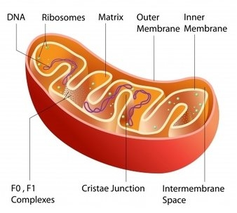
Anatomy of Mitochondria

Slide 25
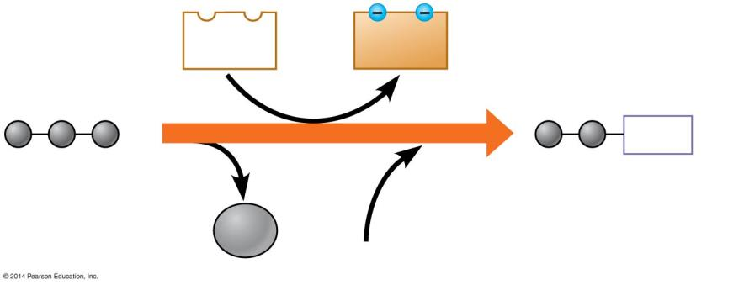
Pyruvate is oxidized in preparation for the citric acid cycle
Pyruvate does not enter the citric acid cycle but undergoes some chemical grooming in which
a carboxyl group is removed and given off as_______
the two-carbon compound remaining is _______________while a molecule of NAD⁺ is reduced to________
coenzyme A joins with the two-carbon group to form acetyl coenzyme A, abbreviated as_____________.
Then _______molecules of acetyl CoA enter the citric acid cycle.
CO₂
oxidized
NADH
acetyl CoA
two
NAD⁺
NADH
+ H⁺
CO₂
2
Acetyl coenzyme A
CoA
Pyruvate
1
Coenzyme A
3
Notes:
25

Slide 26
The citric acid cycle completes oxidation of organic molecules
The citric acid cycle (also called the Krebs cycle after the German-British researcher Hans Krebs) completes the oxidation of organic molecules, and generates many _________ and _______molecules.
Occurs in the __________________
NADH
FADH₂
Mitochondria
Electrons carried by
NADH
FADH₂
Glycolysis
Pyruvate Oxidation
Citric Acid Cycle
Glucose
Pyruvate
CYTOSOL
MITOCHONDRION
ATP
Substrate-level phosphorylation
ATP
Substrate-level phosphorylation
Notes:
26

Slide 27
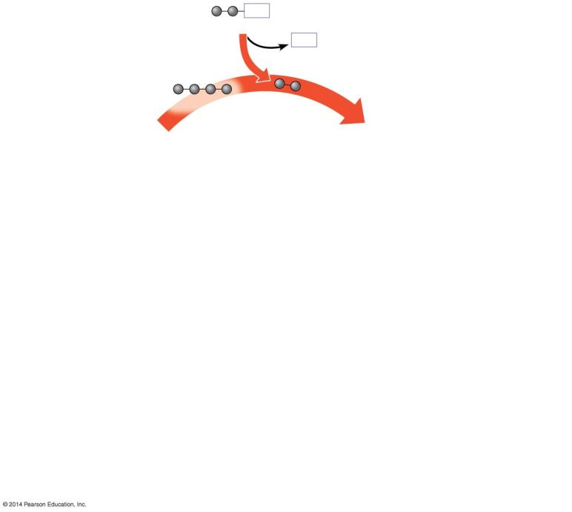
CoA
Acetyl CoA
CoA
2 carbons enter cycle
Oxaloacetate
1
Citric Acid Cycle
1
Step
Acetyl CoA stokes the furnace.

Slide 28
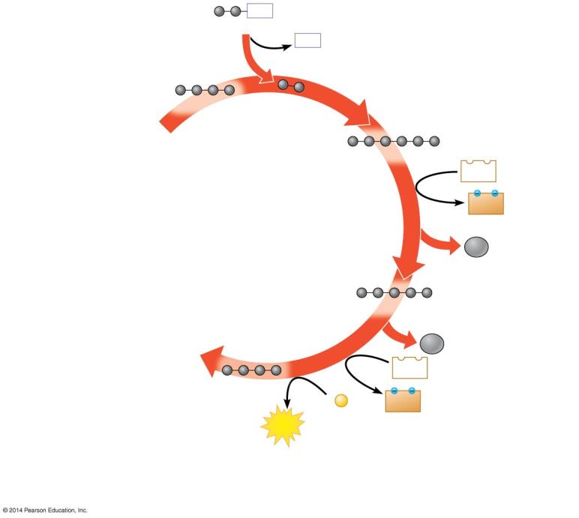
CoA
Acetyl CoA
CoA
2 carbons enter cycle
Oxaloacetate
1
Citrate
NAD⁺
2
NADH
+ H⁺
Citric Acid Cycle
CO₂
leaves cycle
Alpha-ketoglutarate
CO₂
leaves cycle
3
NAD⁺
Succinate
ADP +
P
NADH
+ H⁺
ATP
1
2
Step
Acetyl CoA stokes the furnace.
Steps –
NADH, ATP, and CO₂ are generated during redox reactions.
3

Slide 29
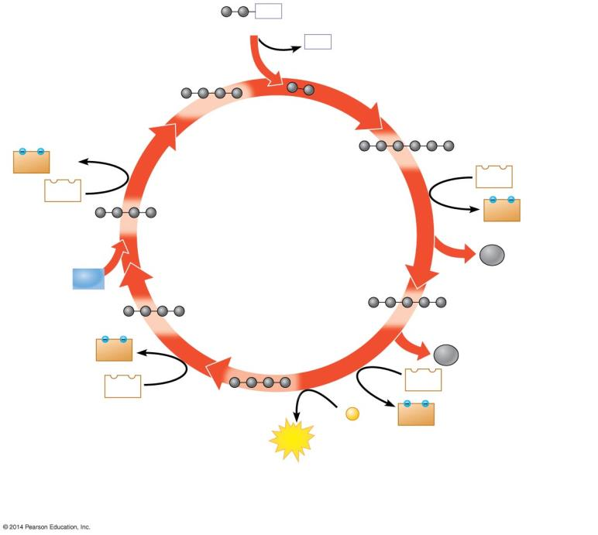
CoA
Acetyl CoA
CoA
2 carbons enter cycle
Oxaloacetate
1
NADH
+ H⁺
Citrate
6
NAD⁺
NAD⁺
2
NADH
+ H⁺
Malate
Citric Acid Cycle
CO₂
leaves cycle
H₂O
5
Fumarate
Alpha-ketoglutarate
FADH₂
4
CO₂
leaves cycle
3
NAD⁺
FAD
Succinate
ADP +
P
NADH
+ H⁺
ATP
1
2
Step
Acetyl CoA stokes the furnace.
Steps –
NADH, ATP, and CO₂ are generated during redox reactions.
Steps –
Further redox reactions
generate FADH₂ and more NADH.
3
4
6

Slide 30
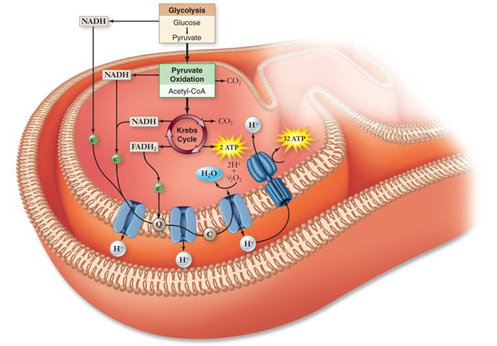

Slide 32
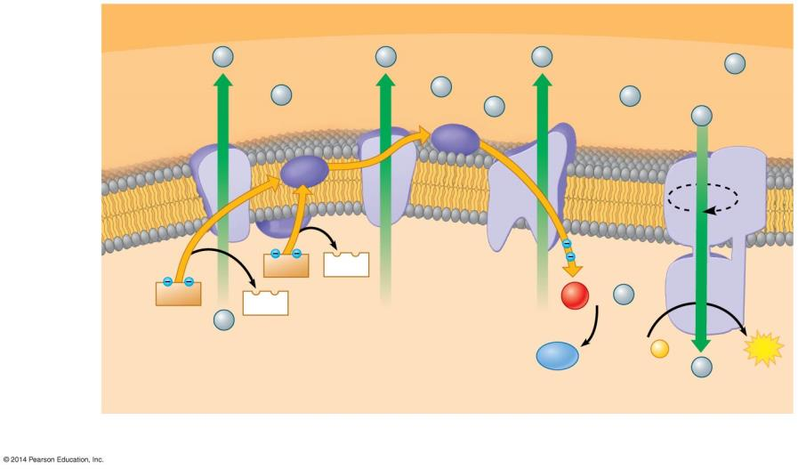
Most ATP production occurs by oxidative phosphorylation
(The Electron Transport Chain)
OUTER MITOCHONDRIAL MEMBRANE
Protein
complex of electron carriers
Mobile electron carriers
H⁺
Intermem- brane space
H⁺
H⁺
H⁺
H⁺
H⁺
ATP synthase
III
Cyt c
I
Q
IV
Inner mito- chondrial membrane
2e
II
Electron flow
FADH₂
FAD
NADH
NAD⁺
H⁺
½ O₂
+ 2
H⁺
Mito- chondrial matrix
H⁺
H⁺
H⁺
H⁺
H⁺
H⁺
H⁺
H₂O
ADP +
P
ATP
Electron Transport Chain
Chemiosmosis
Oxidative Phosphorylation

Slide 33
The Electron Transport Chain

Slide 34
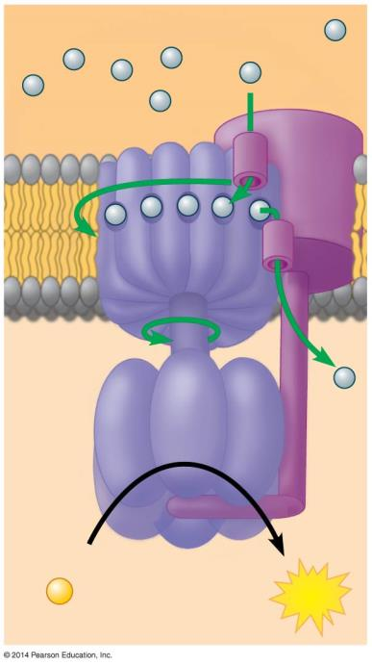
Most ATP production occurs by oxidative phosphorylation
(The Electron Transport Chain)
INTERMEMBRANE SPACE
H⁺
Rotor
Internal rod
Catalytic knob
ADP
+
P
ATP
MITOCHONDRIAL MATRIX

Slide 35
Most ATP production occurs by oxidative phosphorylation
(The Electron Transport Chain)
Thus, after glycolysis and the citric acid cycle, the cell has gained
4 ATP
10 NADH
2 FADH₂
To harvest the energy banked in NADH and FADH₂, these molecules must shuttle their high-energy ______________to an electron transport chain for oxidative phosphorylation
This occurs in the ___________ of mitochondria
electrons
membranes
Notes:
35

Slide 36
4 ATP
6 ATP
glucose
glycolysis
2 NADH
ETC
4 ATP
2 ATP
2 USED TO
SPLIT GLUCOSE
2 pyruvic acid
6 ATP
2 NADH
ETC
18 ATP
ACETYL CO-A
Kreb’s
6 NADH
ETC
4 ATP
2FADH₂
ETC

Slide 37
Overview: Oxidative phosphorylation
The final stage of cellular respiration is oxidative phosphorylation (ETC), which involves electron transport and chemiosmosis and requires an adequate supply of___________.
The electron transport chain is a series of _____________(electron carriers) built into a membrane that accept _____________from high energy NADH and FADH₂
The proteins create an H⁺ ________________________across the membrane and then use the energy of that gradient to drive ATP synthesis.
When the electrons reach the bottom of the ETC they are picked up by the final electron acceptor ________to form_________.
In chemiosmosis, the H⁺ diffuses back across the inner membrane, through ATP synthase complexes, driving the synthesis of ATP.
oxygen
proteins
electrons
concentration gradient
O₂
water
Notes:
37

Slide 38
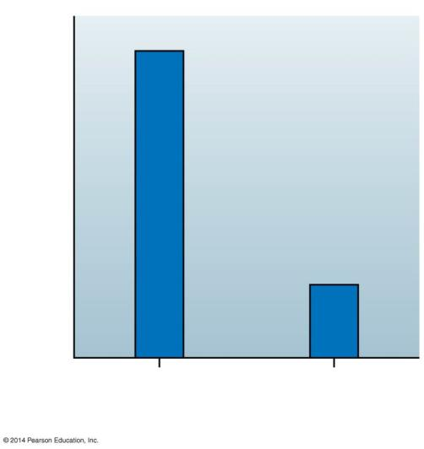
SCIENTIFIC THINKING: Scientists have discovered heat-producing, calorie-burning brown fat in adults
Mitochondria in brown fat can burn fuel and produce heat without making ATP.
Ion channels spanning the inner mitochondrial membrane
allow H ⁺ to flow freely across the membrane
dissipate the H⁺ gradient that the electron transport chain produced, which does not allow ATP synthase to make ATP.
Scientific studies of humans indicate that
brown fat may be present in most people
when activated by cold environments, the brown fat of lean individuals is more active.
Average activity of brown fat
Lean group
Overweight/ obese group
Notes:
38

Slide 39
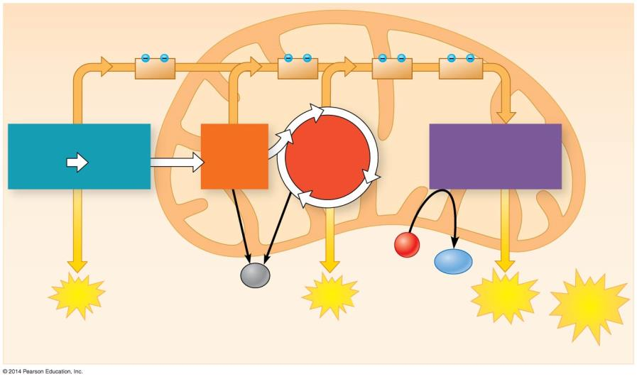
CYTOSOL
MITOCHONDRION
2 NADH
2 NADH
6 NADH
2 FADH₂
Glycolysis
Pyruvate Oxidation 2 Acetyl CoA
Oxidative Phosphorylation (electron transport and chemiosmosis)
2 Pyruvate
Citric Acid Cycle
Glucose
O₂
Maximum per glucose:
H₂O
CO₂
+ 2
ATP
+ 2
ATP
+ about 28 ATP
About 32 ATP
by substrate-level phosphorylation
by substrate-level phosphorylation
by oxidative phosphorylation
Nucleoside diphosphate kinase
GTP+ADP ATP+GDP

Slide 40
Fermentation: Anaerobic Harvesting of Energy

Slide 41
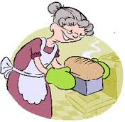
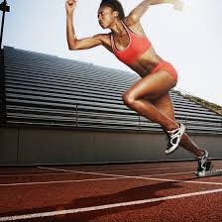
Fermentation enables cells to produce ATP without oxygen
Fermentation is a way of harvesting chemical energy that does not require oxygen.
Fermentation uses glycolysis, produces two ATP molecules per glucose, and reduces NAD⁺ to NADH.
Fermentation also provides an anaerobic path for recycling NADH back to NAD⁺.
Notes:
41

Slide 42
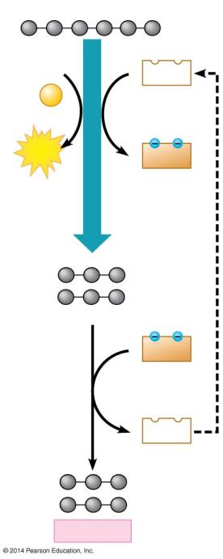
Lactic Acid Fermentation
Your muscle cells and certain bacteria can regenerate NAD⁺ through lactic acid fermentation, in which NADH is oxidized back to NAD⁺ and pyruvate is reduced to lactate.
Lactate is carried by the blood to the liver, where it is converted back to pyruvate and oxidized in the mitochondria of liver cells.
The dairy industry uses lactic acid fermentation by bacteria to make cheese and yogurt.
Other types of microbial fermentation turn soybeans into soy sauce and cabbage into sauerkraut.
Glucose
2 ADP
2 NAD⁺
+ 2 P
Glycolysis
2 ATP
2 NADH
2 Pyruvate
2 NADH
2 NAD⁺
2 Lactate
Notes:
42

Slide 43
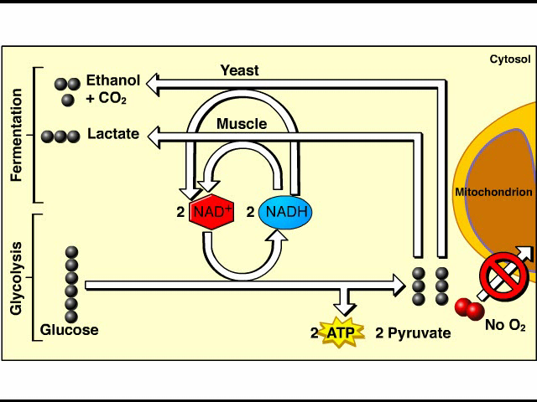
Fermentation Overview

Slide 44
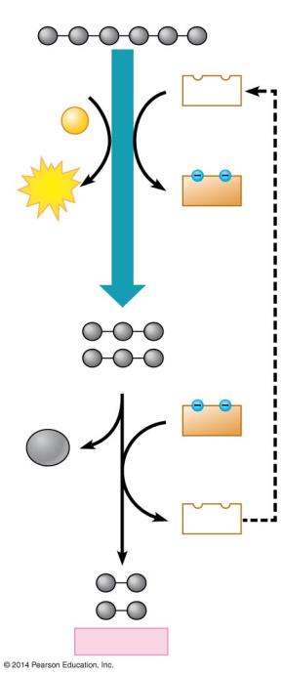
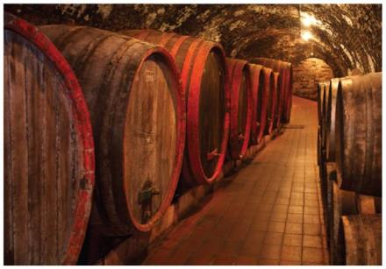
Alcohol Fermentation
The baking and winemaking industries have used alcohol fermentation for thousands of years.
In this process, yeast (single-celled fungi) oxidize NADH back to NAD⁺ and convert pyruvate to CO₂ and ethanol.
Glucose
2 ADP
2 NAD⁺
+ 2 P
Glycolysis
2 ATP
2 NADH
2 Pyruvate
2 NADH
2 CO₂
2 NAD⁺
2 Ethanol
Notes:
44

Slide 45
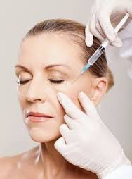
Fermentation enables cells to produce ATP without oxygen
Obligate anaerobes (bacterial cells) require anaerobic conditions, are poisoned by oxygen, and live in stagnant ponds and deep soils. Ex. Clostridium botulinum, causes botulism.
Botox
Facultative anaerobes can make ATP by fermentation or oxidative phosphorylation and include yeasts and many bacteria.
Notes:
45

Slide 46
EVOLUTION CONNECTION: Glycolysis evolved early in the history of life on Earth
Glycolysis is the universal energy-harvesting process of life. The role of glycolysis in fermentation and respiration dates back to life long before oxygen was present, when only prokaryotes inhabited the Earth, about 3.5 billion years ago.
The ancient history of glycolysis is supported by its occurrence in all the domains of life and location within the cell, using pathways that do not involve any membrane-enclosed organelles of the eukaryotic cell.
Notes:
46

Slide 47
Connections Between Metabolic Pathways

Slide 48
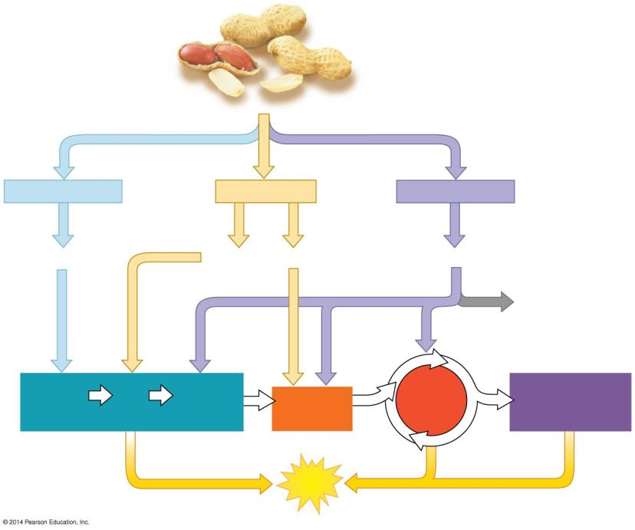
Cells use many kinds of organic molecules as fuel for cellular respiration
Although glucose is considered to be the primary source of sugar for respiration and fermentation, ATP is generated using carbohydrates, fats, and proteins.
Fats make excellent cellular fuel because they contain many hydrogen atoms and thus many energy-rich electrons and yield more than twice as much ATP per gram as compared to a gram of carbohydrate.
Proteins can also be used for fuel, although your body preferentially burns sugars and fats first.
Food, such as peanuts
Carbohydrates
Fats
Proteins
Sugars
Glycerol
Fatty acids
Amino acids
Amino groups
Citric Acid Cycle
Oxidative Phosphorylation
Glucose G3P Pyruvate
Acetyl CoA
Glycolysis
ATP
Notes:
48

